Slide 1
Cloud Adoption Framework for Azure: Security best practices

Slide 2
Agenda
1 Security landscape
2 Cloud Adoption Framework and security
3 Cloud Adoption Framework Secure methodology and disciplines
4 Get started with security tools in Azure
5 Evolve your security posture

Slide 3
Security in the cloud: a shifting landscape What impact is the cloud having on the role of security—and how is security delivered to the customer?

Slide 4







The market is shifting to mobile and cloud— prepare your organization for change, and digitally adapt— get started right—transforming your business, technologies, and security
Market
Business
Technology
Security
Attackers
Notes:
Key Takeaway: Organizations are adapting to three simultaneous transformations at once – business, technology, and security
These start because nearly all external markets are transforming to meet new customer preferences for mobile and cloud technologies. Organizations often face the competitive threat of new technology native startups (like Amazon and Uber) as well as traditional competitors who are using digital transformation to disrupt the market.
The Market Transformation kick off a digital Business Transformation of the business to capture new opportunities and stay competitive against digital native startups.
CLICK 2 - Technology transformation
This digital transformation requires a Technology Transformation for the IT organization to integrate cloud services, modernized development practices, and related changes to keep up with the rapid market evolution.
CLICK 3 - Security Transformation
This should then lead to a Security Transformation that protects these new cloud assets and simultaneously takes advantage of these technologies to better manage threats and security risk
CLICK 4 – Attacker Evolution
Unfortunately, security organizations often function as a kind of “last step” quality gate before release that has to justify budget as a special Capital Expenditure (CapEx).
This engagement model makes it challenging for security to transform, often causing business and IT stakeholders to skip security in order to quickly respond to market needs.
Simultaneously there has been an attacker evolution where attackers rapidly adapt to add these new assets to their list of easy targets
Attack these lower security workloads that are critical to business growth
Find new ways to attack existing assets (both in business models like ransomware and in technical attack techniques)
This creates increased security risk for new workloads and attackers.
Click the zoom for more information on how too little security and too much security (overly restrictive security) lead to the same outcome.

Slide 5
Work together to manage transformation across changing and dynamic market and threat environments
Business
Digital transformation
Market
Technology
Cloud transformation
Attackers
Security
Zero trust transformation
Notes:
Key Takeaway: Everybody must work together during continuous transformations to manage the dynamic market and threat environments
Everyone in the organization is undergoing their own massive transformation and needs to remember they aren’t the only one figuring it out as they go.
Nobody has a clear detailed long term plan that will be accurate in a year or more. Everyone is adapting to a changing environment:
Digital Transformation - Businesses are constantly reading the market and adjusting plans to ensure they are on the right track
Cloud Transformation - Technology organizations are constantly working to keep up with the innovation from the cloud providers (for their own efficiency/effectiveness reasons + helping enable digital transformation)
Zero Trust Transformation – Security is constantly adapting to the changing threat environment + changing technology platform driven by cloud + changing attack surface and priorities based on the digital transformation.
Each of these has a consistent general direction of what they are trying to achieve, but the details and processes are often changing frequently.
Its critical for everyone to work together to manage the dynamic market and dynamic threat environment so that the organization stays safe and reduces risk in the time of transformation that we are in.
To enable this, organizations should build a culture that increases empathy for each other, builds productive relationships, shares context across these disciplines, and encourages learning and collaboration.
This is challenging at many organizations that have a traditional silo’ed approach. Business leaders need to set a tone and a culture, model it, and hold their people accountable to do the same

Slide 6


Pick a middle ground that fits your risk appetite identify tradeoffs together, and work through decisions in teams— continuously balance—adapt rapidly to the cloud—and address security risks.
High Agility
Balanced
High Security
Security
Skipping security increases number and impact of security incidents
Restrictive security inhibits productivity and incentivizes people to bypass authorized systems and protections
Productivity
Too little security
Increased risk
Too much security
Notes:
Key Takeaway: Too little security and too much security (overly restrictive security) lead to the same outcome – more risk
Organizations need to avoid the trap of either too much security or too little security driving up risk
If you skip security completely, your risk of a security incident that disrupts business operations is very high (no surprise)
CLICK 1
What may surprise you is that dialing up security also leads to increased risk. This is because strict security processes can make it hard for people to do their job developing new capabilities to meet the market, motivating those teams to bypass security entirely and putting out systems that (ironically) are lower security and present a higher risk to the business.
Organizations need to recognize both adapting rapidly to the cloud and addressing security risks are important priorities. You should pick a middle ground that fits your risk appetite and ensure both teams work together to identify the tough tradeoffs and work through them together.
If the business teams or security teams have the ability to override the other teams, you will probably have a higher number of security incidents and damage business because of it.
Scraps
Friction generates “Shadow IT”
Bypass standard process
IT + security must support anyway
There are different risk levels in security depending on the risk appetite of the organization (how much you value speed/productivity vs. safety / incident avoidance), but you always have to avoid the extreme ends of the spectrum.
There is always risk at all levels, but you can make it worse by going for an extreme
Too much security incents people to go around the system to be productive (ultimately/ironically undermining security goals)
Too little security increases risk of security incidents (ultimately/ironically undermining productivity goals if when ransomware hits)

Slide 7
Security is shifting towards continuous improvement
Governance
Driving continuous improvement
Architecture
Access assets
Posture management
Innovate with assets
Access control
Zero Trust
Innovation security
DevSecOps
Asset
Protection
Security Operations
Policies and standards

Slide 8


Attacker’s opportunity types (car-key-driver) Security should be understood by everyone
Technology (car) Software logic in the system
Exploit common vulnerabilities in well known software
Infrastructure - Common Elements like Device, Operating System, Virtualization and Containers/Kubernetes (emerging)
Applications that run on infrastructure (often specialized and highly varied across organizations)
Exploit unique vulnerabilities in your custom/bespoke applications and websites
Compromise supply chain to embed attacker logic in your software
Exploit configuration weaknesses to abuse system functionality
Attack cryptography - Find and abuse mathematical weaknesses
Key Authorized credentials/keys/tokens/etc.
Username/password and supporting information (MFA, session tokens, etc)
Cryptographic key theft of underlying system secrets
Human (driver)
Authorized personnel
Trick, distract or persuade humans with authorized control over the target asset(s)

Slide 9
Microsoft Cloud Adoption Framework: Where is security? Overview of the Cloud Adoption Framework and how security intersects methodologies

Slide 10
Microsoft Cloud Adoption Framework for Azure. Achieve balance. Deliver modernization.
Best practices
Achieve balance
Templates
People
Process
Technology
Control & Stability
Documentation
Speed & Results
Tools
Align—business, people and technology strategy
Achieve—business goals with actionable, efficient, and comprehensive guidance
Deliver—fast results with control and stability
Notes:
<Key point>: Change is more than adopting technology. It’s adapting how you do business.
The Microsoft Cloud Adoption Framework for Azure means changing how you do business—not just swapping out technology, but changing your enterprise, the culture behind it, and you too.
We share best practices from our employees, partners, and customers who have already undertaken the cloud journey.
The Cloud Adoption Framework brings together people, process, and technology—a strategy that’s aligned to your business goals.
Quickly—efficiently, and with actionable guidance, it provides guidance for your organization’s agile business transformation.
Leading people through change is difficult. It’s not just the technology that changes. It’s your people and processes too.
We can help guide you through.
<Transition>: How does cloud adoption work alongside your organization’s people, process, and technology?

Slide 11
Objective of this model—to create balance
To achieve balance, we must first recognize that security is everywhere
and everyone in the company is responsible for some aspect of security.
Capture business opportunities → Increase agility
Strengthen security → Mitigate security risk

Slide 12
Microsoft Cloud Adoption Framework for Azure
Security is a discipline you practice along your entire cloud adoption path
Define strategy
Define motivations, and create a business case leveraging cloud economics
Plan
Create actionable cloud adoption plan aligned to the strategy
Ready
Prepare cloud environments with Azure landing zones
Ready
Prepare cloud environments with Azure landing zones
Adopt
Migrate or Innovate
Design, build and deploy workloads to Azure
Security is a critical design area here
Govern
Automate governance baseline and empower delegated responsibility
Govern
Automate governance baseline and empower delegated responsibility
Manage
Build operations baseline and support enterprise operations
Manage
Build operations baseline and support enterprise operations
Secure
Establish security baseline and manage security posture
Security is a discipline of governance & automated guardrails
Security drives your operations baseline implementation
All of which depend on sound security posture management

Slide 13
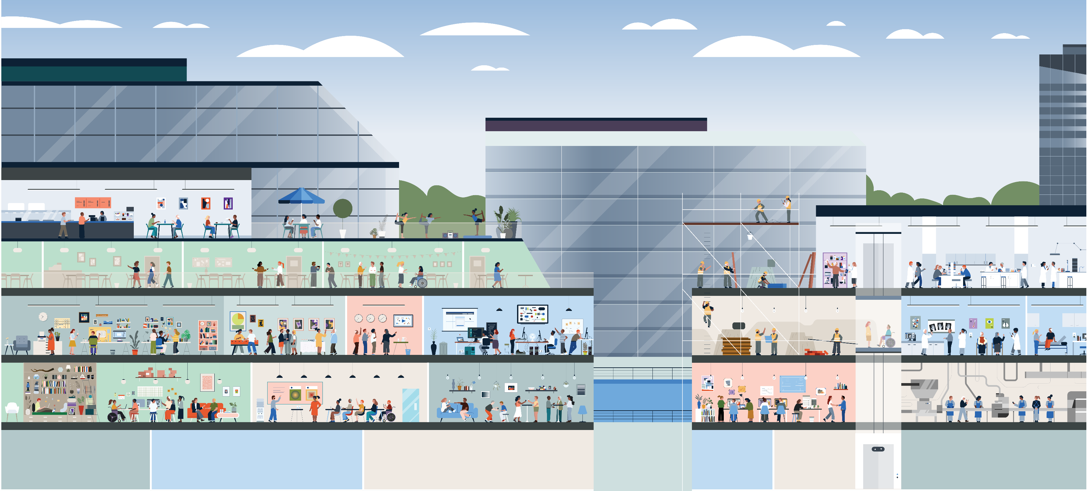
A tale of two city [structures]
Existing building:
Business needs are being met, but decisions makers want to improve compliance and modify the environment
New building:
An entirely new building is required to meet business and compliance needs

Slide 14
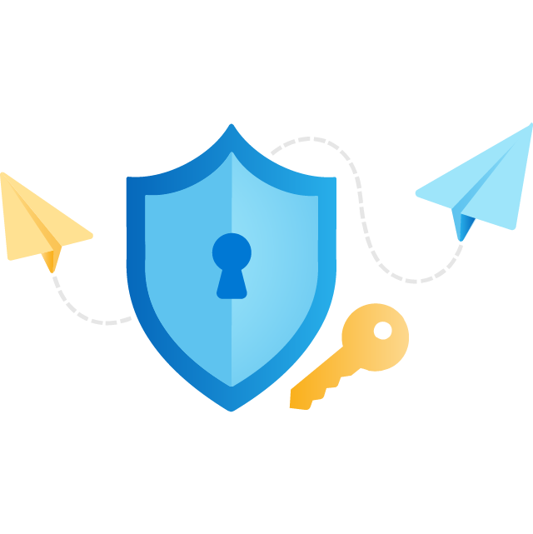

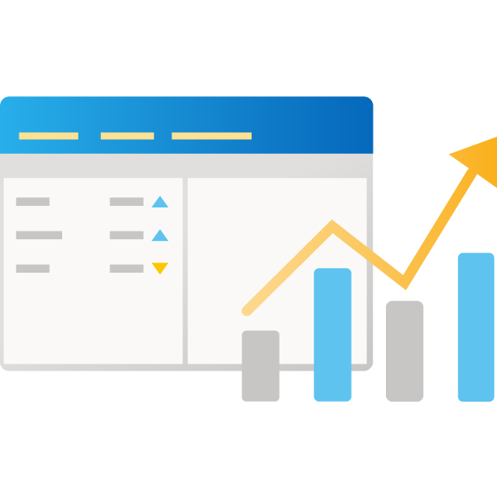

Understanding compliance and design
Behind the scenes, each building must:
Security: Keep out bad actors & minimize mistakes from good actors
Management: Manage the building to keep things working properly
Governance: Monitor for risky activities and automate guard rails
Building design: Design and create the building's structure and rooms
Existing building:
Older buildings may have limits on how smart they can become. Security and operations may be more human intense.
New building:
Smart buildings, elevators, locks, etc. allow for more automated governance & less human compliance

Slide 15
How does security fit with other elements of the building?
Security is a team responsibility
Governance: monitor for risky activities & automate guard rails
Security: keep out bad actors and minimize mistakes from good actors
Governance can help automate detection & enforcement to protect safe boundaries
Security is expected to:
Provide security services (staff the security desk)
Establish security rules & guidelines to stay safe
Recover when security is compromised
Leverage technology to monitor and react quickly
Management: manage the building to keep things working properly
Operations can help recover and aid in monitoring actions, when bad actors sneak in
Building design: design and creation of the building and rooms
Security should be strategically included in your building design to maximize impact

Slide 16
Microsoft Cloud Adoption Framework for Azure
Security is a discipline you practice along your entire cloud adoption path
Define strategy
Define motivations, and create a business case leveraging cloud economics
Plan
Create actionable cloud adoption plan aligned to the strategy
Ready
Prepare cloud environments with Azure landing zones
Ready
Prepare cloud environments with Azure landing zones
Adopt
Migrate or Innovate
Design, build and deploy workloads to Azure
Security is a critical design area here
Govern
Automate governance baseline and empower delegated responsibility
Govern
Automate governance baseline and empower delegated responsibility
Manage
Build operations baseline and support enterprise operations
Manage
Build operations baseline and support enterprise operations
Secure
Establish security baseline and manage security posture
Security is a discipline of governance & automated guardrails
Security drives your operations baseline implementation
All of which depend on sound security posture management

Slide 17
Microsoft Cloud Adoption Framework Secure methodology

Slide 18




Security guidance
CEO
Securing digital transformation
Business leadership
Business and security integration
CIO
CISO
Technical leadership
Security strategy, programs, and epics
Initiative planning/execution
Microsoft cybersecurity reference architectures (MCRA)
Cloud Adoption Framework (CAF)
Zero Trust
Privileged Access
Azure Top 10
Architecture and policy
Ransomware
Architects and technical managers
Technical planning
Microsoft security documentation
Azure Security Benchmark
Implementation
Product docs Azure | Microsoft 365
Well-Architected Framework (For Azure workload owners)
Implementation
May 2021 https://aka.ms/MCRA
Feedback and additional resources:
https://aka.ms/markslist
@MarkSimos
Notes:
Key Takeaway: This is a visual depiction of how securing business assets maps to technical implementation and Microsoft security guidance to help you with each step

Slide 19


Cloud Adoption Framework – Secure methodology End state for managing your overall security posture
Business alignment
Secure
Business alignment
Establish cross-org processes to scale cloud security throughout your business
Risk insights
Integrate security insights into risk management framework and digital initiatives.
Security integration
Integrate security insights and practices into business and IT processes
Operational resilience
Ensure organization can operate during attacks and rapidly regain full operational status.
Security disciplines
Security disciplines
Implement proven security processes built on modern, cloud-based security tools
Access control
Establish Zero Trust access model. Extend modern protection to legacy assets.
Security operations
Detect, respond, and recover from attacks; hunt for hidden threats; lead through data-driven decision
Asset protection
Protect sensitive data and systems. Continuously discover, classify & secure assets.
Security governance
Continuously identify, measure, and manage security posture to correct deviation and reduce risk.
Innovation security
Integrate security into DevSecOps processes. Align security, development, and operations practices.
Cloud security team
Establish team with expertise and experience for security and cloud. Often a cross-functional security team(s) that includes members of security team, cloud center of excellence (CCoE), Cloud operations, IT operations, and others.

Slide 20
Access control Simplify security—and make it more effective
Classic approach Restrict everything to a secure network
Zero trust Protect assets anywhere with central policy
Notes:
This diagram resulted from a collaboration with The Open Group where Microsoft is an active participant
Zero Trust brings security to the users, data/information, applications, APIs, devices, networks, cloud, etc. wherever they are – instead of forcing them onto a “secure” network. In other words, Zero Trust shifts the perceived role of security restricting business to security enabling business

Slide 21
Security operations
Mission: to reduce organizational risk by detecting, responding to, and recovering from active attacks on enterprise assets.
Key cultural elements
Mission alignment
Continuous learning
Teamwork
Key measurements
Responsiveness - mean time to acknowledge (MTTA)
Effectiveness- mean time to remediate (MTTR)

Slide 22








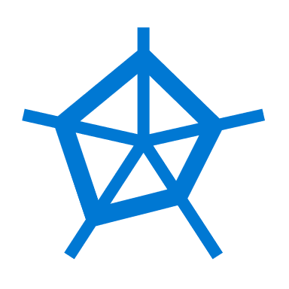



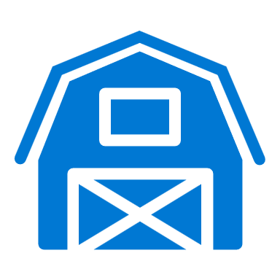




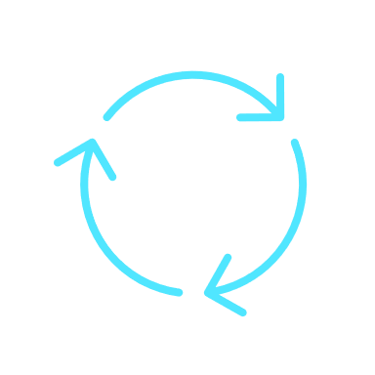
Security governance
Business goals + risk
Architecture and policies
Align technology to business
Hybrid estate of multicloud and on-prem IT + OT + IoT
Architecture, policy, and standards
Security posture management
Continuous discovery of assets and asset types
Continuous improvement of asset security posture
Policy-driven governance
Consistent execution
Compliance and reporting
Ongoing accurate accountability
Notes:
Key Takeaway: Security governance (and architecture) provides the bridge from business priorities to technical reality and the oversight to ensure visibility and security assurances are sustained
Business goals and risk provide the true north star for security, ensuring that security is focusing efforts on what matters to the organization and is informing the risk owners using familiar language and processes in the risk management framework
Compliance and reporting on external security requirements (and optionally internal policy) are the basic required elements of operating in a given industry. The mandatory requirements are like feeding the bear in the zoo, if you don’t feed it every day, it may eat you.
CLICK 1 – Architecture and Standards
Architecture, Standards, and Policy provide the critical translation from business requirements and risk into the technical environment. We strongly recommend a unified view across your enterprise estate rather than splitting up cloud vs. on premises. Attackers don’t care about your internal processes and will attack any point in the organization and move laterally if that is the easiest path to their target. Most enterprises today are a hybrid environment that spans
On-premises – including multiple generations of technology, often significant numbers of legacy software and hardware (and sometimes operational technology controlling physical systems with a potential life/safety impact).
Clouds – typically including multiple providers for
Software as a Service (SaaS) applications
Infrastructure and Platform as a Service (IaaS/PaaS) providers
CLICK 2 - Security Posture Management
Security posture management is a new/emerging function that represents the convergence (or near-convergence) of several related security functions focus on the question of “how secure are we?” including vulnerability management and collecting security compliance data for regulatory reporting. The key tenets of success for this are
Continuous discovery of assets and asset types. The cloud is a dynamic environment where new types of services are offered regularly and workload owners dynamically spin up and down instances of applications and services as needed. Governance teams need to perform continuously discovery to keep up with this pace of change.
Continuous improvement of asset security posture. Attackers are continuously evolving, defenses are continuously improving, and you can’t always get all the security in the initial configuration, so governance teams should focus on continuously improving standards and enforcement of them.
Policy Driven Governance provides consistent execution by fixing something once in policy that is automatically applied at scale across resources. This limits wasted time/effort on repeated manual tasks and is often implemented using Azure Policy or 3rd party policy automation frameworks
Additional information
Any critical active governance alerts that are raised after hours are typically handled by Security Operations as that organization usually has 24x7 visibility for critical configuration issues
We are seeing a natural convergence of some functions that have often been viewed as separate “security” vs. “compliance” functions. In the on-premises datacenter era, these functions were typically scoped and managed differently because of constraints
Compliance - assessing all security risk was required by regulation and often took months because of the manual effort required to complete it, so it was only done every few years
Security – some security functions required fast turnaround, so they focused on a limited scope like software vulnerability management.
Because the cloud now allows for on-demand reporting of many security risk factors, we are starting to see tooling consolidation (e.g. Azure Security Center reports both secure score and compliance using the same datasets). This is also leading to increased convergence between security and compliance.

Slide 23
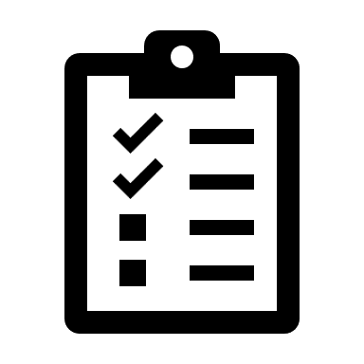


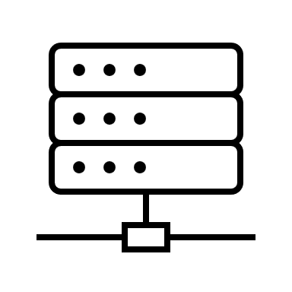
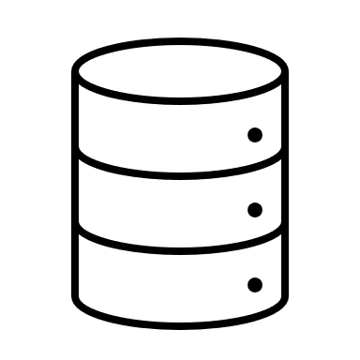




Asset protection
Get secure—by applying security standards to:
Protect data at rest and in transit
Safeguard asset-specific configurations
Stay secure—applying ongoing asset maintenance to:
Keep software/firmware/etc. patched and up to date
Keep software and protocols current
Architecture, policy, and standards
Notes:
Key Takeaway: Asset Protection provide the critical execution of standards across resources
Each asset type and security requirements are unique (identities, endpoints, applications, Azure services, etc.), but the security standards for any asset type should be consistently applied to all instances.
Asset protection is primarily focused on consistent execution of security controls at scale (preventive, detective, and other controls) to meet the policies, standards, and architecture of the organization. Asset protection typically acts as the technical subject matter expert for assets (which is a continuous journey of learning) while working with other disciplines (governance, architecture, security operations, workload teams, etc.). Asset protection ensures that policy and standards are feasible, enables implementation of controls to support the policy and standards, and provides feedback for continuous improvement.
Asset protection critically important because threat actors are persistent and seek out gaps in the application of standards and policy to exploit. Attackers can directly target the business-critical data or application, but also frequently target the underlying infrastructure that grants them access to the business-critical data and applications.
Get Secure
The first focus area for asset protection is to Get Secure. The two activity types of getting secure are:
Greenfield - Ensuring that new assets are configured and new asset types are configured to standards is critical to avoid continuously creating technical debt that has to be addressed later at a greater expense (and results in increased risk exposure until that is done).
Brownfield – retrofitting new security controls to existing assets. Organizations often operated IT environments for decades with security as a low or nonexistent priority, resulting in a large amount of technical debt (weak security configurations, unpatched software, unencrypted communication or storage, legacy software and protocols, etc.). Bringing security controls up to current standards and policy is critical to avoid increasing risk as attackers increase their ability to exploit it for profit with ransomware and other illicit business models)
Get Secure roughly maps to Capital Expenditures (CapEx) dynamics. The budget and cost to implement security should be linked to the creation of the asset (e.g. new software project, growth of an application, cloud adoption initiative, etc.) for greenfield. For brownfield, this is usually a special project funded to bring security controls up to standards/compliance.
CLICK 1 - Stay Secure
Everything wears out or degrades over time including security configurations and standards, and this happens faster than ever in the cloud age with continuous evolution of capabilities. Part of sustaining asset protection is continuing to apply the latest best practices.
Examples
Continuous Cloud Improvement - Azure Storage, SQL, and others regularly add security features to detect attacker activity that wasn’t available when the service first launched.
Software End of Life - Any software, including Windows and Linux Operating sytems, will always reach end of life and security updates won’t be provided for them, potentially leaving business critical data and applications exposed to attackers.
Taking advantage of these changes requires ongoing investment and resources to ensure that your security posture improves with available capabilities and doesn’t degrade over time. Stay Secure roughly maps to Operational Expenditures (OpEx) as it is an ongoing cost
Getting started – Asset protection can be challenging for newer resource types like Azure and AWS Services. You should focus first on
Well-known resources like VMs, networks, identities, etc. that the team is familiar with (and which are easier to manage with newer cloud tools like Azure Security Center and Azure Defender).
Baselines in Azure Security Benchmark – Microsoft provides security configuration guidance for specific Azure services that are aligned to the Azure security benchmarks
Additional Information
Responsible Teams - Asset Protection may be performed by IT operations teams responsible for enterprise-wide assets, DevOps/DevSecOps teams responsible for their workload’s assets, or security teams working with the IT or DevOps/DevSecOps teams.
Cloud Elasticity – Unlike on premises, cloud resources may be created and destroyed over short timeframes. As needed, workloads can spin up more instances of servers, Azure Functions, etc. to perform a job and then spin them down afterward within (something within month, but sometimes within minutes or hours). Your asset protection processes and measurements should take this into account.
Manage Exceptions - Once a best practice is identified for an asset, it should be consistently applied to all instances of it. While temporary exceptions may need to be approved, these should be managed closely with expiration dates to ensure that temporary exceptions don’t become a permanent risk from attackers.
Challenges Measuring Value - One of the difficulties with measuring the business value of asset protection investments is that the impact of a problem isn’t often apparent until there is a real-world failure. Just like changing your oil in a car seems like an expensive nuisance until the engine fails, security vulnerabilities can appear silent and invisible until an attacker exploits them.
Favor Automated Policy - Asset protection should favor automated enforcement and remediation mechanisms like Azure Policy or another automation framework. This helps avoid cost and morale issues from repeatedly performing manual tasks (and increased security risk from human errors)

Slide 24

Innovation security
Secure innovation= your organization's beating heart in the digital landscape
Responsive to needs
Meets business and customer requirements for market relevance
Dev
Sec
Safe and secure
Provides confidentiality, integrity, and availability + regulatory compliance
Ops
Quality and performance
meets the quality, speed, scalability, reliability, and other expectations
Notes:
Key Takeaway: Security should feel natural, important, and part of everyone’s job, just like business requirements, performance, and reliability
Innovation is the beating heart of an organization in today’s digital landscape, keeping the organization competitive in marketplaces that include both digital native startups and digitally transforming traditional organizations.
Pragmatically, this is composed of modifying existing DevOps processes and sometimes adding in new elements that fit naturally into the process. All of these should be tuned to create only healthy friction that generates important bugs to fix and valuable critical thinking like threat modeling to understand the attacker “user persona” and aboiding unhealthy friction / wasted effort.
For example the DevOps standup may have an agenda to review alert types and the security ones are skipped over because nobody understands what they mean. A security engineer can highlight which ones are important and high risk vs. which ones are probably noise or lower prioritity.
The DevOps team may also not have enabled security elements in the development tools and CI/CD process as they didn’t know it existed or how it could help.
Innovation is the beating heart of an organization in today’s digital landscape, keeping the organization competitive in marketplaces that include both digital native startups and digitally transforming traditional organizations.
For innovation to be successful and sustainable, it must meet the minimum viable product (MVP) requirements and expectations across DevSecOps domains:
Development – Business requirements for market/customer relevance and responsiveness changing needs
Security – Ensuring safety, confidentiality, integrity, and availability
Operations – Quality, Performance, and reliability requirements and expectations
Additional Information
Lack of operations and support rigor can result in “Instant legacy” dynamic where applications are not properly supported starting on the first day of production use.

Slide 25
Security baseline: Get started

Slide 26
Accelerate security with native tools
Business alignment
Secure
Risk insights
Integrate security insights into risk management framework and digital initiatives.
Security integration
Integrate security insights and practices into business and IT processes
Operational resilience
Ensure organization can operate during attacks and rapidly regain full operational status.
Security disciplines
Azure AD
M365 Defender
Azure Firewall
Azure RBAC & ABAC
Azure DDoS
Azure Web Application Firewall
Azure AD B2B
Azure AD B2C
Azure Bastion
Azure Lighthouse
Directory Federation
Directory Replication Azure Networking
Azure Portal
Subscription Design
Hybrid Identity
Management Groups
PrivateLink
Access control
Establish Zero Trust access model. Extend modern protection to legacy assets.
Security operations
Detect, respond, and recover from attacks; hunt for hidden threats; lead through data-driven decision
Asset protection
Protect sensitive data and systems. Continuously discover, classify & secure assets.
Security governance
Continuously identify, measure, and manage security posture to correct deviation and reduce risk.
Innovation security
Integrate security into DevSecOps processes. Align security, development, and operations practices.
Azure Defender
Azure Sentinel
M365 Defender
Azure Blueprints
Azure Policy
Defender for Cloud
Azure Networking
Azure Storage
Encryption
Management Groups
Defender for Cloud
Azure Blueprints
Azure Policy
Azure RBAC & ABAC
Secure Score
Compliance Dashboard
Resource Locks
Azure DevOps
GitHub Advanced Security
Resource Manager Templates
Azure Automation
API Management Gateway
Azure DDoS
Azure Web App Firewall
Azure Site Recovery
Azure Backup

Slide 27
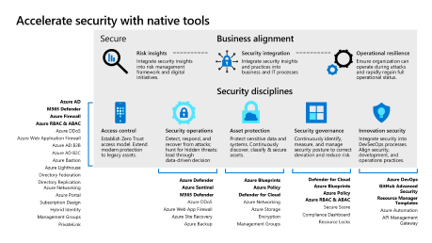
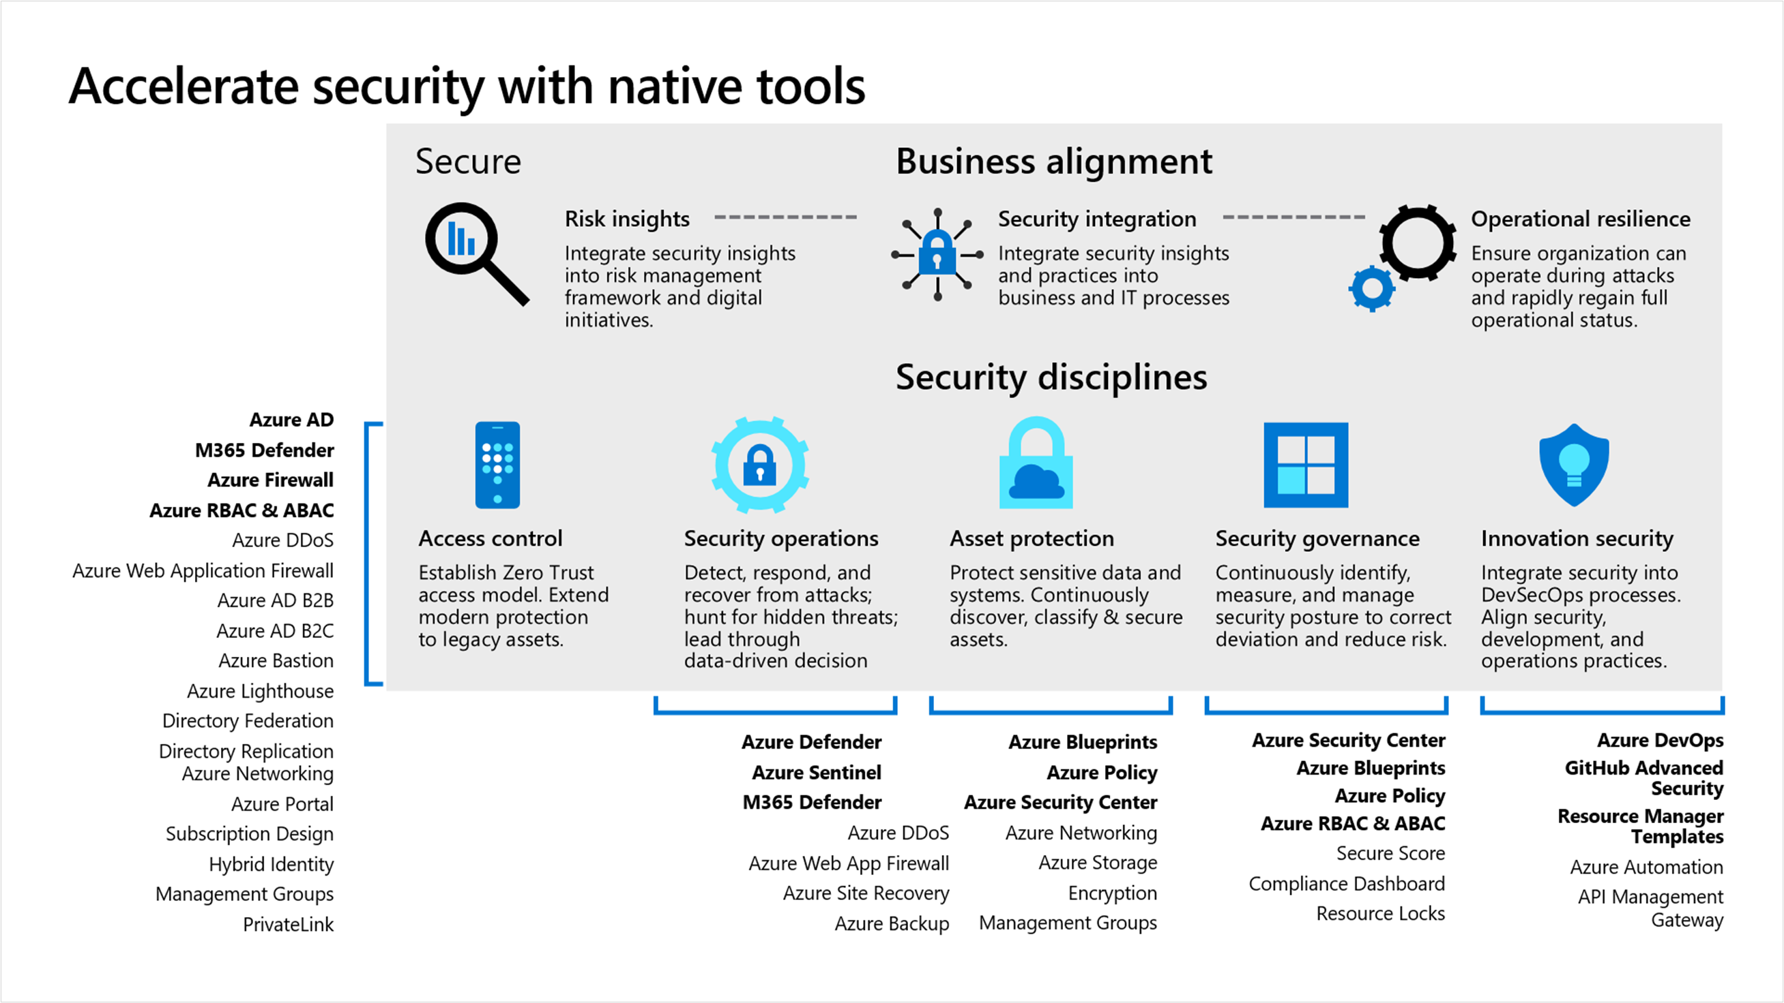
Establish a security foundation
Don’t try to learn every security tool today. Take a balanced approach to implementation—audit, learn, then apply.
Security foundation
Start small. Establish processes that quickly evolve as cloud adoption and cloud security mature.
Improve your security posture based on risks identified in the cloud adoption plans.
Continuous improvement
As additional iterations of cloud adoption are planned, the risk profile will change.
Incrementally expand processes for each security discipline, which will require expertise in additional tools.
Notes:
We have done an assessment lets focus on a few areas that we can address within the time frame allocated. Note we are building an MVP with you to get something established, once this is done we can continue to evolve to further improve.

Slide 28
What makes a good security foundation?
Built for scalability
Secure by design
Accounts for governance
Well defined networking design
Fully understood and controlled permissions and identities
No standing access ever
Deployed through Infrastructure as Code
The state of the MVP is always known and controlled with approvals
Notes:
<jeff> Should this go away?

Slide 29
Getting started
Deploy the Azure landing zone accelerator
Implement Azure security services
Rich, mature, scaled-out implementation
4 implementations: Start small to Enterprise-scale
Includes full set of products and controls
Intended to get organizations to security at scale, quickly
Customizable implementation
Deploy through portal or integrate with GitHub
Opinionated guidance based on best practices and lessons learned
Deployment includes:
Dedicated subscriptions for specific functions (optional)
Management Group structure
Network topology (hub and spoke or vWAN)
Azure Policy – enforcement options
Azure Firewall (optional)
Azure Security Center
Azure Defender (optional)
Azure Sentinel (optional)
Azure Network Security Groups (optional)
Azure Monitor (Log Analytics, Audit Logging)
Small footprint, starter feature-set
Develop and iterate at your own pace
Work with partners to customize the iterations, based on your specific requirements (e.g. scale-out, or enhanced policy controls)
Deployment includes:
Upgrade to Azure Defender - Azure Security Center
Web Application Firewall deployment tutorial
Deploy and configure Azure Firewall Premium
Manage Azure DDoS Protection Standard using the Azure portal
Overview of the Azure Security Benchmark V2
CIS Microsoft Azure Foundations Benchmark v1.3.0 blueprint sample
Azure Security Benchmark blueprint sample overview
Cloud Adoption Framework - Security Methodology
Enterprise-Scale/policies.json
Notes:
Context
As organizations start out on their cloud adoption journey, they may want to start with a proof-of-concept approach that starts small in order to evaluate technologies and architectures and iterate and expand over time.
This would be based around a greenfield subscription, potentially in a brownfield tenant.
The primary use case is starting small – learning and iterating. It is not intended to be a ‘one and done’ deployment, it is a small core set of products aimed at demonstrating the Microsoft security story.
Customers and partners would use this toolkit as the basis for discussions, planning and further technical implementation work in order to build out an environment that meets their needs.
Alternatively, the intention to adopt Azure as the strategic path may already have been decided and the requirement is to get to scale and maturity quickly.
In this scenario, the customer and partner will have identified the need to deploy a full environment and will use the Enterprise Scale implementations to build out a comprehensive architecture in Azure with multiple subscriptions and expanded policy configuration.
In a subset of scenarios, some customers may wish to use both approaches – deploying an Enterprise scale implementation to establish a broad set of capabilities to jumpstart the Azure adoption, but also use a smaller deployment for a separate use-case, or in order to develop a specific security operations environment.
For these scenarios, there are two approaches.
Security starter toolkit
- Intended for organizations who are early in their cloud journey and are looking to get hands on with Azure security technologies
Enables the quick deployment of the essential Azure security technologies – Security Center, Defender and example policies
Intended to be used for PoC/Pilot environments, or developed further with a partner to create a fully-featured environment
Could also be deployed as a greenfield subscription in a existing (brownfield) tenant, in order to create the foundation for a new security management subscription (with further development)
Enterprise Scale
Intended for organizations who need to achieve maturity and scale quickly
Based on a mature reference architecture that enables customers to build out a full Azure environment based on guidance from Microsoft
An opinionated configuration that deploys specific configuration (e.g. policies, management group structure)
Intended as a greenfield deployment, with the opportunity to migrate brownfield workloads/subscriptions into it (project planning, change controls, testing required)

Slide 30
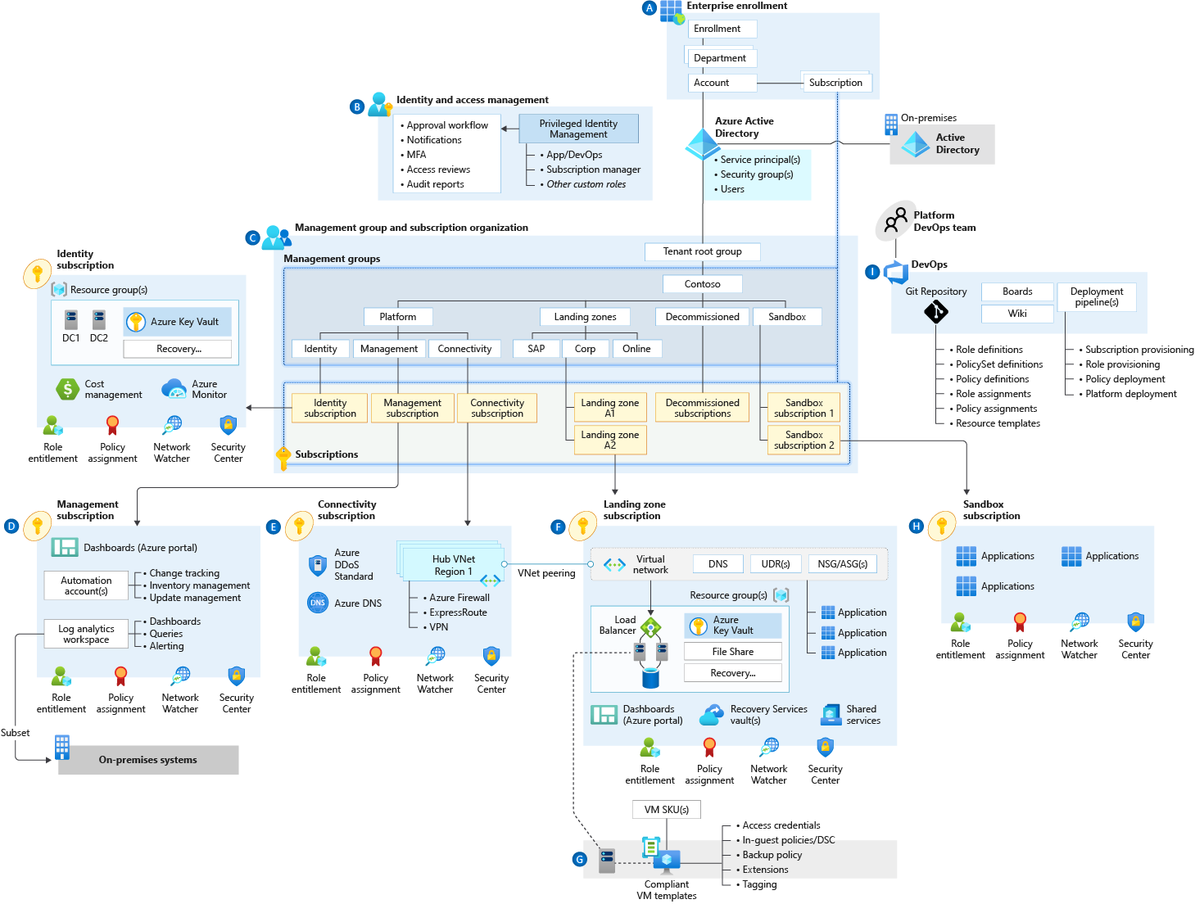
Azure landing zones (including security)
The Azure landing zone accelerator provides a full implementation—
the complete architecture, with foundational security tools
Best practice Include security tools with Azure landing zone architecture provides:
Target end-state for most organizations
Scaled out, mature environment
Broad range of Microsoft best practices for Azure environment design
Strong foundation for organizations to establish consistent management, governance and security processes
Notes:
‘Start’ – move towards accelerated architecture with accelerator
‘Align’ – review design areas and asses what parts need to be improved.
‘evolve’ – what other processes can be built on top.
Irrespective of where you are at in your journey, this is the best practice aligned architecture we want to implement.

Slide 31
Disciplines and best practices: Improve your security posture

Slide 32
Security disciplines
Access control
Security operations
Asset protection
Security governance
Innovation security
Establish Zero Trust access model to modern and legacy assets using identity and network controls
Detect, respond, and recover from attacks—hunt for hidden threats; share threat intelligence broadly
Protect sensitive data and systems. Continuously discover, classify, and secure assets
Continuously identify, measure, and manage security posture to reduce risk and maintain compliance
Integrate security into DevSecOps processes. Align security, development, and operations practices.
Notes:
Microsoft is constantly investing across these five domains. We spend in excess of a billion dollars a year to develop tools and capabilities to help ensure the security of the Azure platform. Microsoft Azure provides confidentiality, integrity, and availability of customer data, while also enabling transparent accountability. We have this internal saying, “Microsoft runs on trust”. We have to be trusted by our customers, by our partners, and by the governments and the institutions that we work with globally.
This review covers all five of these verticals, in 5 days, we are trusting that you to validate security configurations, identify weaknesses, and provide triage guidance.

Slide 33
Security best practices
Access control
RBAC controls, Identity, NSGs, Firewalls, WAF, Gateways, Encryption, …
Security operations
Sentinel (SIEM/SOAR), BCDR
Asset protection
Azure Policy, encryption, backup
Security governance
Defender for Cloud, Blueprints, Management Groups
Innovation security
Security architect, secure DevOps, secure development practices
Notes:
FastTrack for Azure security team will be looking for proper configuration of the following during review of an AMMP engagement. Obviously, this is not an exhaustive list, and the FastTrack for Azure team is working on a checklist that will assist you during the engagement.
Similar to the Landing Zone review, we will be looking to have partners complete the checklist and be able to discuss any and all applicable items.
You will notice the MCAS is not directly called out – this belongs to the O365 FastTrack team – however we will be looking to see if they are an 0365 customer that MCAS portal is in use and connected to Sentinel when it fits their operational model.
To dive into the weeds a bit, one of the key metrics we are looking for is an improved Secure Score between the start of the engagement, and the end of the engagement.

Slide 34
Why are these disciplines important?
National security
Client data
Productivity impact
Intellectual property protection
Accidental change
Brand/reputation erosion
Business continuity
Competition
Operational efficiency
Disgruntled employees
Employee retention
Partner relationships
Extortion - ransomware
Notes:
These will all be very familiar to security sellers and security engineers. Security is often seen as the biggest inhibitor to a cloud-first journey—but in reality, it can be its greatest accelerator, by providing a trusted platform for any workload.
The objectives of the AMMP program are twofold, to find and remediate the ‘’low hanging fruit’ in a customers security posture, and to identify the areas where additional effort is required to remediate gaps across the five security disciplines.

Slide 35






The demo environment
Web server 1
Defender for Cloud
Users
Web Application Firewall App GW
Azure Firewall Premium
Azure Sentinel
Web server 2
Notes:
Today we are going to show you four technologies that will help your customers secure their environments. We have created two web servers that sit behind Azure Firewall Premium, that is in turn behind Web Application Firewall running on an Application Gateway. These servers are in turn monitored by Security Center to ensure that best practices are being observed, and both are also connected to Sentinel to help customer quickly identify and remediate any breach of the system. So with that I’ll turn it over to our first presenter, Manny, to walk you through Application Gateway and Azure Firewall Premium.

Slide 36
Demo: Azure Web Application Firewall on Application Gateway
Access control

Slide 37
Demo: Azure Firewall Premium
Access control
Notes:
Firewall Premium –

Slide 38
Demo: Defender for Cloud
Security governance
Notes:
Focus on policy around Web Servers (recommendations) – integration and then a nice transition statement to Sentinel -ie ‘what do use to detect and remediate a breach’.

Slide 39
Demo: Azure Sentinel
Security operations
Notes:
Load Sentinel Portal Sentinel is a both a SIEM Security Incident & Event Management, and a SOAR, Security Operations And Response. This means that Sentinel is used to both identify threats and to responds either automatically or through an analyst’s action.
Sentinel has five key components,
First, data connectors, that enable the transfer of data from a source to a log analytics workspace that is Sentinel enabled
Second analytics in the form or rules, User and Entity Behavior Analytics,
Third, Hunting, the ability to look for threat patterns using queries or Juypter notebooks
Fourth, alert and incident identification and management
Fifth, remediation, through automated response or analyst action.

Slide 40
Next steps

Slide 41
Resources
Review the Cloud Adoption Framework Documentation
Review the Cloud Adoption Framework Security Documentation
Learn with the Cloud Adoption Framework Learn Modules
Watch the CAF Security Video on Azure Enablement Show

Slide 42
Thank you.

